Slide 1
Overview UART
Full UART Module with Parity
  Implemented ASM chart.
  3 modules implemented and instantiated together.
    Baud Rate Generator
    Receiver
    Transmitter
  Implemented logic to combat metastability.
  Implemented self-checking testbench
Method order and Goal
  Specification/Requirements
  Design Capture using Verilog
  RTL functional Simulation
  Logic Synthesis
  Place and Route (Implementation)
  Generate Bitstream
  Program Device
Specification/
Requirement
Design Capture using Verilog
RTL functional Simulation
Logic Synthesis
Place and Route
Generate Bitstream
Program Device
Key Point-Overview Review: UART

Slide 2
Specification/Requirements
Individual modules
Baud Generator, Receiver, Transmitter
rst
Baud Generator
  Requirements/Specifications
    To generate a sampling signal whose frequency is exactly 16 times the UART’s designated baud rate from the system clock.
    Account for any adjustments needed for an accurate count
Receiver
  Requirements/Specifications
    Obtain data at a specific baud rate , oversampled x16
    Implement false triggering detection, allowing to detect any Start Bit that is less than half-bit time as noise
    Minimizing metastability
    Implement a parity bit
Transmitter
  Requirements/Specifications
    Shift register that loads data in parallel then shifts it out bit by bit at a specific rate(baud rate).
    A bit is shifted out ,LSB first, every 16 enable ticks.
    The receiver and transmitter must have the same baud rate as the baud rate generator
    Implement a parity bit
Baud Rate Generator
baud16_ena
rst
tx_start
transmitter
tx_start
tx_data
tx_data
txd
baud16_ena
baud16_ena
tx_busy
rst
Receiver
rxd
rxd
rx_data
baud16_ena
baud16_ena
rx_valid
framing_err
Key Point – Specification/Requirements of Baud Generator, Receiver, and Transmitter

Slide 3
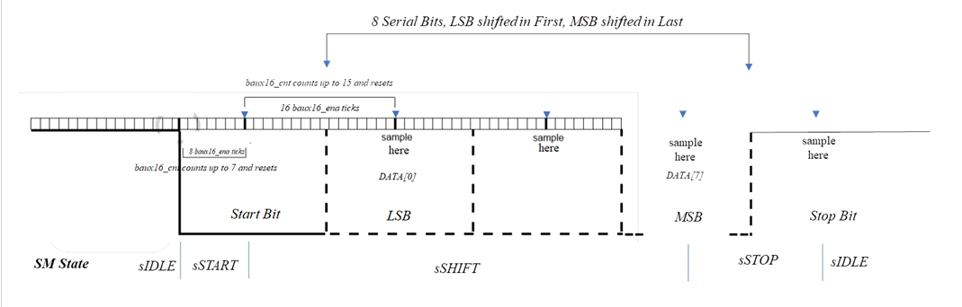
UART Receiver DESCRIPTION
What is UART Receiver?
UART (Universal asynchronous receiver and transmitter)
  Includes a transmitter and receiver
    Receiver
      Shift register that receives the data at a specific baud rate bit by bit via oversampling then reassembles the data.
      The receiver and transmitter must have the same baud rate ➔ baud rate generator
  States
    sIDLE: Active high(1), held in active high to show that the line and transmitter are not damaged.
    sSTART: Active low(0), to signals the receiver that new data is coming.
    sSHIFT: Receives the incoming data, LSB first, gets held in a shifting register.
    sSTOP: Signals to the receiver that the incoming data is finished.

Slide 4
UART Transmitter DESCRIPTION
What is UART Transmitter?
UART (Universal asynchronous receiver and transmitter)
  Includes a transmitter and receiver
    Transmitter (The focus of the presentation)
      Shift register that loads data in parallel then shifts it out bit by bit at a specific rate(baud rate).
      A bit is shifted out ,LSB first, every 16 enable ticks.
      The receiver and transmitter must have the same baud rate ➔ baud rate generator
  States
    sIDLE: Active high(1) txd, awaits tx_start signal to load data word.
    sWAIT: Waits one clock cycle before transitioning to Active Low(0) txd.
    sSTART: Active low(0) txd, to signal the receiver that new data is coming, transmit first bit(LSB) in the data register.
    sSHIFT: Transfers the data bit by bit every 16 enable ticks.
    sSTOP: Transmits and active low(0) txd signal for 1 clock cycle.

Slide 5
Clock Improvement with Fractional Adjustment for Baud Rate Generator
Fractional Adjustment | Common Baud rates bits/second
1/8 = 0.125 | 115200: 27.126
2/8 = 0.250 | 57600: 55.253
3/8 = 0.375 | 38400: 81.380
4/8 = 0.500 | 28800: 108.507
5/8 = 0.625 | 230400: 13.563
6/8 = 0.750 | 19200: 162.760
Without Adjustment (50MHz) 115200 baud rate
  Rounded Value
    Period = 27 x (20ns)= 540ns
    Oversampled 16x = (540ns) x 16 = 8640ns
  Real Value
    27.126736 x (20ns) x 16=~8680ns
  Absolute error
    8680ns – 8640ns = 40ns (A difference of 40ns)
With Adjustment (baudx16_ena period is extended by one 50MHz (20ns) clock every 8th baudx16_ena)
  Oversampled adjusted value
    14x(27x20ns) + 2(28x20ns) = 8680ns
  Absolute error
    8680ns-8680ns = ~0
  The Error bit-time is near zero
Every 8th time the baud generator sends a pulse, it has one extra to adjust the clock for the baud rate
(System clock) divided by (desired baud rate)
Key Point – Clock Improvement for Baud Rate Generator

Slide 6
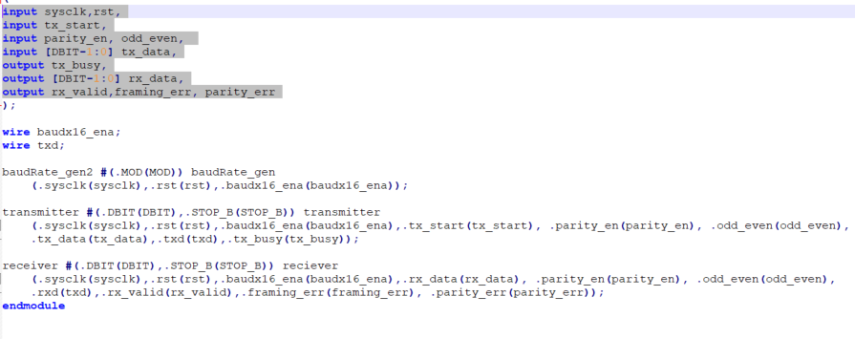
UART Instantiation
Structural Description
Shows how the two modules are connected, txd to rxd
Module instantiation of UART
  Sharing the same baud rate generator
  txd ➔ rxd
  Purpose:
    Combining individual modules into one.
Circuit for loop back test for UART module, used in the test bench
Variables:
  rst: resets the circuit
  baud16_ena: sends a pulse every 16 count, responsible for the baud rate
  tx_start receives a 1-clock-wide pulse to initiate transmission
  tx_data: receives the data being transmitted
  txd: output of the transmitter, sends data serially to the receiver
  tx_busy: no new data for the input of the transmitter if high, only accepts new data when low.
  rxd: receives bits
  rx_data: outputs the 8 data bits
  rx_valid: UART received data valid
  framing_err: for a framing error
+1
rst
UART
rst
tx_start
transmitter
Receiver
tx_start
rx_data
rst
tx_data
tx_data
txd
rst
rxd
Baud Rate Generator
baud16_ena
tx_busy
baud16_ena
rx_valid
baud16_ena
framing_err
Key Point – UART Instantiation

Slide 7
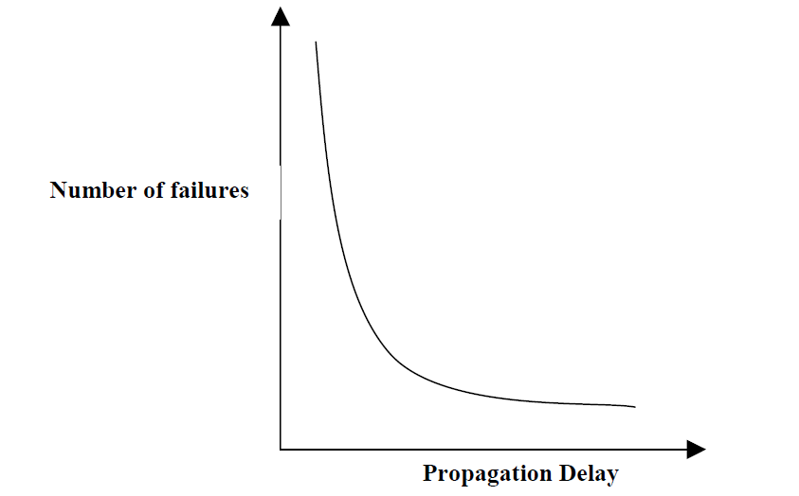
Metastability
Brief overview
Characteristics
  A probabilistic phenomenon (random future events)
    Can not build a bit-stable device that cannot go into a metastable state
  Occurs when two asynchronous signals combine such that their resulting output goes into an indeterminate state
  Can remain in a metastable state for an indeterminant amount of time.
    Exponentially decreasing function, it will stay in the metastable state.
Solution
  D-type Flip Flop in series, on the same system clock.
  Increases the amount of time for the meta-state to be resolved
  Minimizes the probability that the metastability entering the main part of the circuit.
sysclk
Asynchronous input
D
Q
D
Q
Key Point - Metastability
Note: in this design rxd_q[] represents the synchronizer

Slide 8
Block Diagram of parity_bit
Data (4)bits | Even | Odd
0 | 0 | 1
1 | 0 | 1
1 | 1 | 0
0 | 0 | 1
 | 0 | 1
Block diagram, Truth table
odd_even decides if the parity_bit is going to be calculated with an odd or even configuration.
  parity_bit will be a 1 or 0 depending on the amount of data bits
  odd_even = 0: even parity (keep an even number of 1’s)
  odd_even = 1: odd parity (keep an odd number of 1’s)
Calculated the same with transmitter(thr[0]) or receiver (rxd_q[1])
Purpose
  Adding a parity bit is a form of error detection. Compares the parity from the receiver and transmitter. If they are both the same, no error, if they are different an error has occurred.
Even number of 1’s
Output of transmitter
Parity bit:
Even : parity bit ⬅ 0
Odd : parity bit ⬅ 1
odd_even
D
Q
parity_bit
thr[0] / rxd_q[1]
Key Point - Parity bit, block diagram
input of receiver

Slide 9
ASM CHART RECEIVER
Purpose: The ASM chart is part of the design methodology used.
A powerful tool that makes easy to understand the operation of a digital system represented by an ASM chart, self-documenting, reduces design errors, and allows more efficient designs.
STATES: sIDLE, sSTART, sSHIFT, sSTOP
sIDLE
parity_err ⬅ 1’b0
rx_valid ⬅ 1’b0
framing_err ⬅ 1’b0
parity_bit ⬅ odd_even
sSHIFT
sPARITY
parity_bit:
Resets parity_bit to odd_even
0
rxd_q[1]
Baudx16_ena
0
1
Baudx16_ena
0
1
0
1
Baudx16_cnt ==
4’d15
baudx16_cnt⬅ baudx16_cnt+1’b1
Baudx16_cnt ==
4’d15
0
baudx16_cnt⬅ baudx16_cnt+1’b1
1
rxd_q[1]
1
parity_bit:
Calculates the parity_bit by XOR incoming received bits
1
parity_bit ⬅ parity_bit^rxd_q[1]
rsr⬅ {rxd_q[1], rsr[7:1]}
Baudx16_cnt⬅4’d0
0
parity_bit ⬅ parity_bit^rxd_q[1]
baudx16_cnt = 4’d0
0
bitcnt ==3’d7
0
bitcnt⬅bitcnt+1’b1
Calculations of parity_err:
Calculates error by xor parity_bit from receiver and transmitter (rxd_q[1])
No error = 0
error = 1
Baudx16_ena
1
1
baudx16_cnt⬅ baudx16_cnt+1’b1
bitcnt⬅ 3’d0
parity_en
1
0
1
baudx16_cnt⬅4’d0
0
Baudx16_cnt ==
4’d7
sSTOP
sSTOP
parity_err ⬅ 1’b0
(Continued on next slide)

Slide 10
(Continued on previous slide)
sSTOP
Baudx16_ena
0
1
Baudx16_cnt ==
4’d15
0
baudx16_cnt⬅ baudx16_cnt+1’b1
1
0
rxd_q[1]
1
Baudx16_cnt⬅4’d0
parity_err:
- If parity_bit is 1, a parity_err has occurred and parity_err⬅parity_bit
No error = 0
error = 1
framing_err←1’b1
Baudx16_cnt⬅4’d0
rxd_valid←1’b1
parity_bit
parity_err⬅parity_bit
ASM CHART: RECIEVER cont.

Slide 11
ASM CHART Transmitter
STATES: sIDLE, sWAIT, sSTART, sSHIFT, sPARITY, sSTOP
sIDLE
txd ⬅ 1’b1
txd_busy ⬅ 1’b0
parity_bit ⬅ odd_even
sPARITY
sSHIFT
sSTART
tx_start
0
0
Baudx16_ena
0
1
0
Baudx16_ena
thr ⬅ tx_data
txd_busy ⬅ 1’b1
Baudx16_ena
1
1
1
Baudx16_cnt ==
4’d15
0
baudx16_cnt⬅ baudx16_cnt+1’b1
Baudx16_cnt ==
4’d15
0
baudx16_cnt⬅ baudx16_cnt+1’b1
Baudx16_cnt ==
4’d15
0
baudx16_cnt⬅ baudx16_cnt+1’b1
sWAIT
1
1
1
parity_bit ⬅ parity_bit^thr[0]
thr ⬅ thr >> 1
Baudx16_cnt⬅4’d0
Baudx16_cnt⬅4’d0
txr ⬅ 1'b1
Transmit 1’b1 high
Indicates sIDLE state
txd ⬅ thr[0]
Baudx16_cnt⬅4’d0
bitcnt ⬅ 3’d0
0
Baudx16_ena
bitcnt ==3’d7
1
1
parity_bit:
Calculates parity bit as the data bits are being transmitted.
parity_en
txr = parity_bit
parity_bit:
Sends parity_bit
1
sSTOP
0
0
txd⬅1’d0
txd ⬅ thr[0]
bitcnt⬅bitcnt+1’b1
txr = 1'b1
sSTOP

Slide 12
(Continued on previous slide)
sSTOP
Baudx16_ena
0
1
Baudx16_cnt ==
4’d15
0
baudx16_cnt⬅ baudx16_cnt+1’b1
1
Baudx16_cnt⬅4’d0
ASM CHART: TRANSMITTER cont.

Slide 13
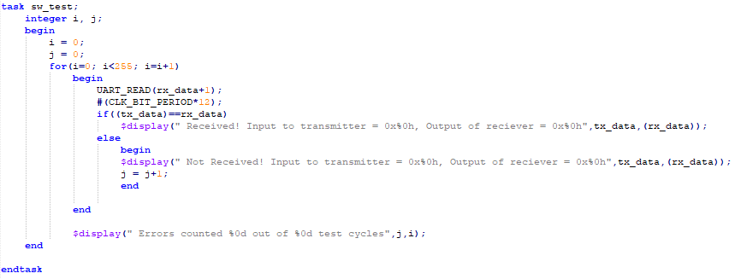
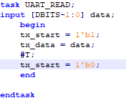
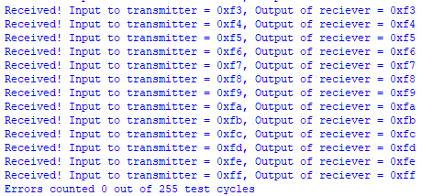
SELF-CHECKING LOOP BACK TESTBENCH
Iterative
A Task that sends data to the transmitter
Iterating through 0-255
End portion of the test, iterating
0xf3 ➔ 0xff
Purpose: the self-checking loop back test sends data from the receiver back to transmitter while iterating through all possible combinations for 8-bits, 255 not counting 0, different values. The Self-checking happens by an output in the terminal, letting the user know if the data is received and how many errors if any.
No errors out of 255 test cycles

Slide 14
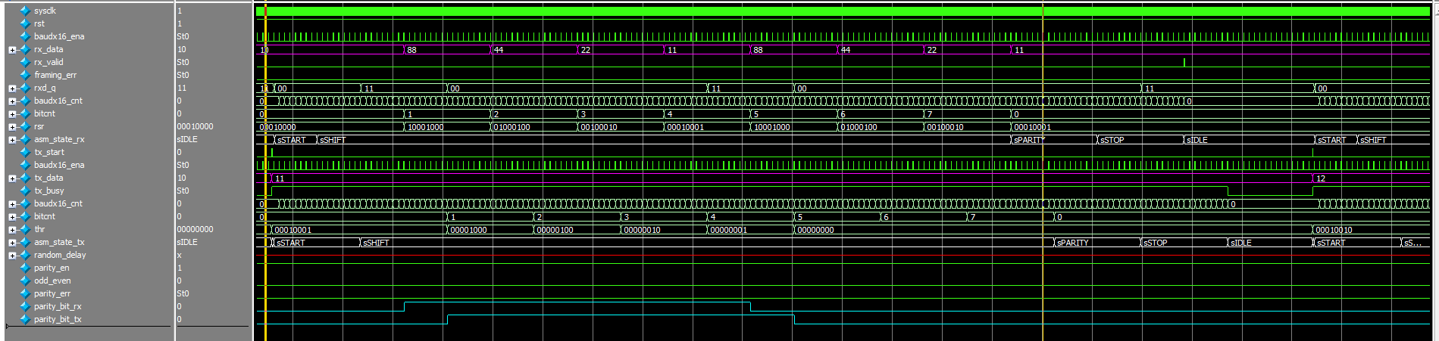
Self-Checking Loop Back Test Waveform: EVEN PARITY
Iterative, Full Wave Form, parity_en = 1 , odd_even = 0
Receiver(top) States:
  sIDLE
  sSTART
  sSHIFT
  sPARITY
  sSTOP
parity_bit calculations
parity_bit ⬅ 0
Calculated parity_err
  parity_err ⬅ 0
  parity_bit ⬅ 0
  0x11 should have a 0 parity bit for even configuration
The input to the transmitter and output of the receiver
tx_data (Bottom)
rx_data (Top)
Description: shows the wave form for when the parity_en =1 and has an even configuration. The results are that the circuit is working just as expected
Transmitter(bottom) States:
  sIDLE
  sWAIT
  sSTART
  sSHIFT
  sPARITY
  sSTOP
Synchronizer received bit, rxd_q = 00, which is expected with an even parity configuration

Slide 15
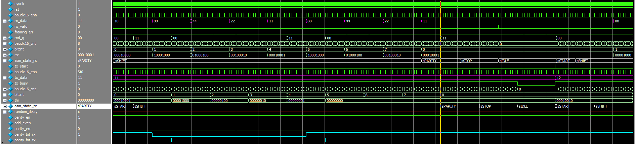
Self-Checking Loop Back Test Waveform: ODD PARITY
Iterative, Full Wave Form, parity_en = 1 , odd_even = 1
The input to the transmitter and output of the receiver
tx_data (Bottom)
rx_data (Top)
Transmitter(bottom) States:
  sIDLE
  sWAIT
  sSTART
  sSHIFT
  sPARITY
  sSTOP
parity_bit calculations
parity_bit ⬅ 1
Calculated parity_err
  parity_err ⬅ 0
  parity_bit ⬅ 1
  0x11 should have 1 parity bit for odd configuration.
Description: shoes the wave form for when the parity_en =1 and has an odd configuration. The results are that the circuit is working just as expected
Receiver(top) States:
  sIDLE
  sSTART
  sSHIFT
  sPARITY
  sSTOP
Synchronizer received bit, rxd_q = 11, which is expected with an odd parity configuration

Slide 16
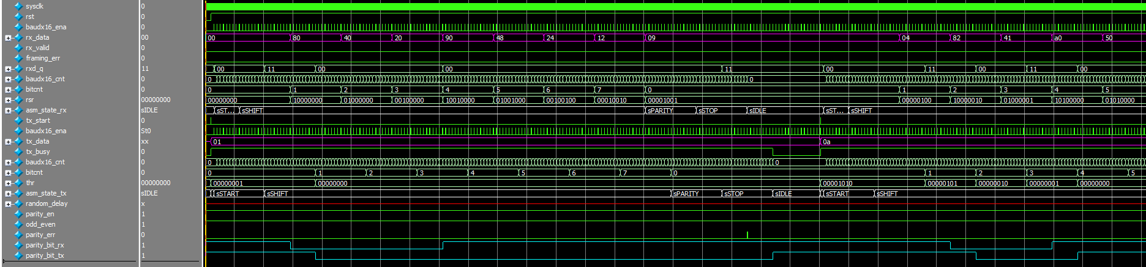
Self-Checking Loop Back Test Waveform: ODD PARITY ERROR TEST
Iterative, Full Wave Form, parity_en = 1 , odd_even = 1
The input to the transmitter and output of the receiver
tx_data (Bottom)
rx_data (Top)
Receiver(top) States:
  sIDLE
  sSTART
  sSHIFT
  sPARITY
  sSTOP
parity_bit calculations
parity_bit ⬅ 1 (error)
Calculated parity_err
  parity_err ← 1 for 1 pulse.
parity_bit ⬅ 1 (error)
  0x01 should have 0 parity bit for Odd configuration.
If parity_bit⬅1 , then rx_valid⬅0
Description: shows the wave form for when the parity_en =1 and has an odd configuration. An error is purposely put in the design to show that the parity_err will pulse. Everything in the circuit is working as expected
Transmitter(bottom) States:
  sIDLE
  sWAIT
  sSTART
  sSHIFT
  sPARITY
  sSTOP

Slide 17
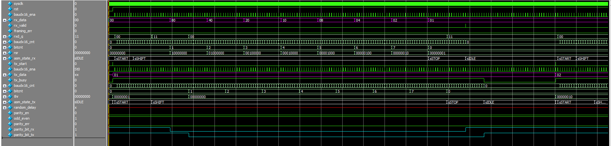
Self-Checking Loop Back Test Waveform: parity_en ⬅ 0
Iterative, Full Wave Form, parity_en = 0 , odd_even = 1
Receiver(top) States:
  sIDLE
  sSTART
  sSHIFT
  sSTOP
The input to the transmitter and output of the receiver
tx_data (Bottom)
rx_data (Top)
parity_en ⬅ 0
description:
With parity_en⬅0, skips the sPARITY state completely for both the transmitter and receiver.
Still calculates parity_bit but the transmitter doesn’t send the parity_bit.
Transmitter(bottom) States:
  sIDLE
  sWAIT
  sSTART
  sSHIFT
  sSTOP

